Slide 1
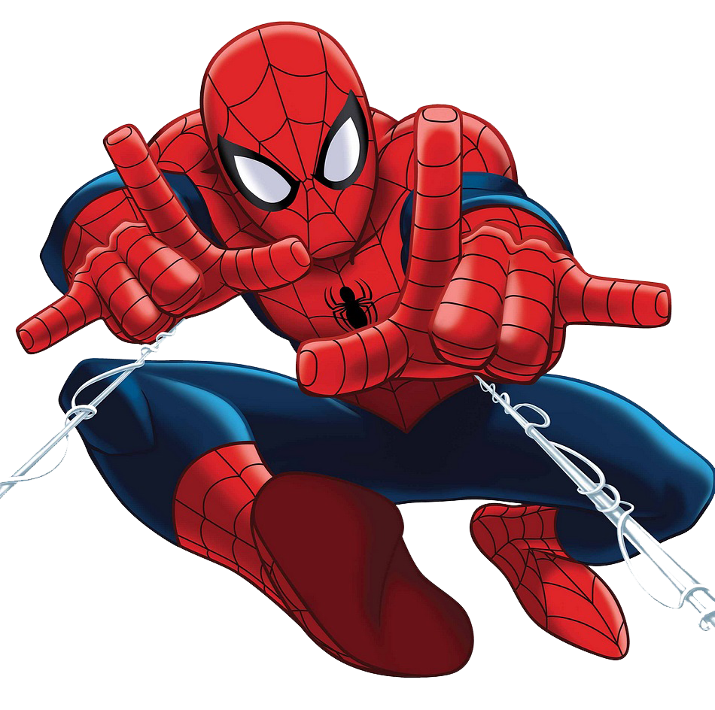
MANUEL
MANUEL
HAPPY BIRTHDAY
HAPPY BIRTHDAY

