Slide 1
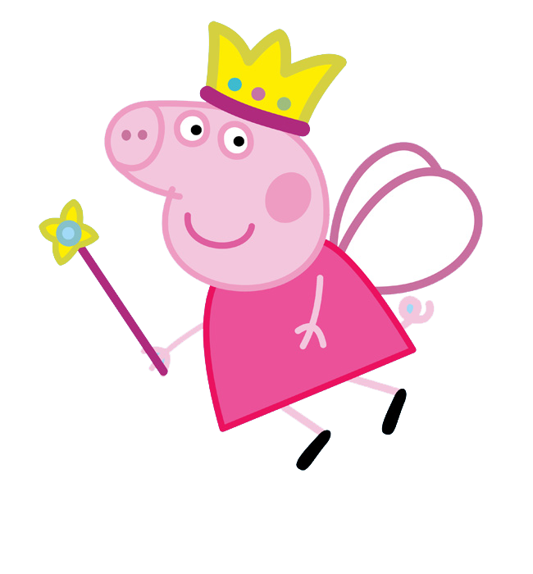
2
2
2
BELLA
BELLA
BELLA

