Slide 1
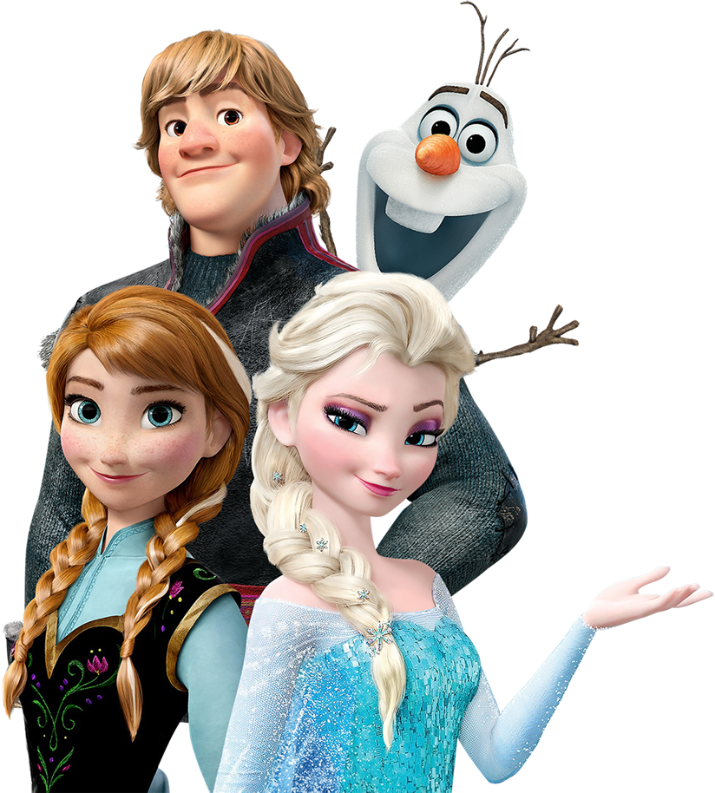
5
5
5
ANGELA
ANGELA
ANGELA
HAPPY BIRTHDAY
HAPPY BIRTHDAY
HAPPY BIRTHDAY

