Slide 1
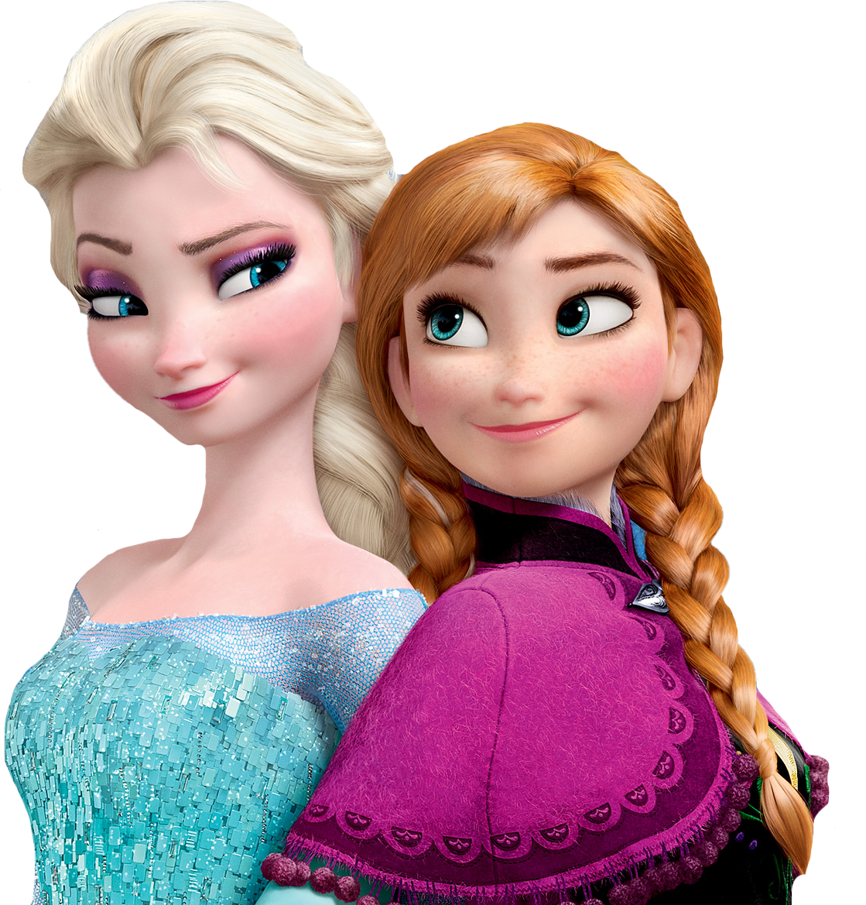
ANGELA
ANGELA
ANGELA
HAPPY BIRTHDAY
HAPPY BIRTHDAY
HAPPY BIRTHDAY

