Slide 1
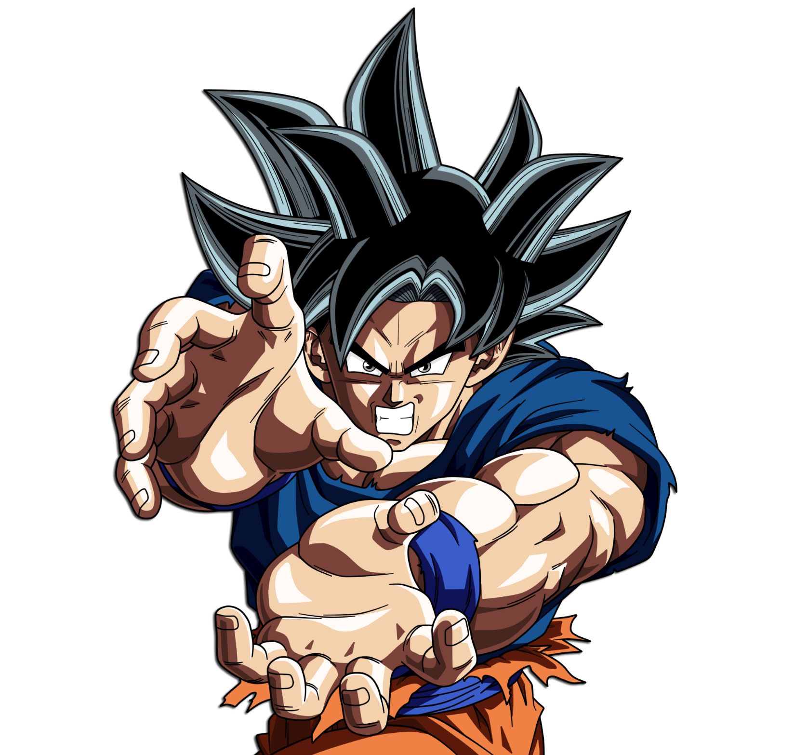








8
don
bran
happy
birthday

